Slide 1

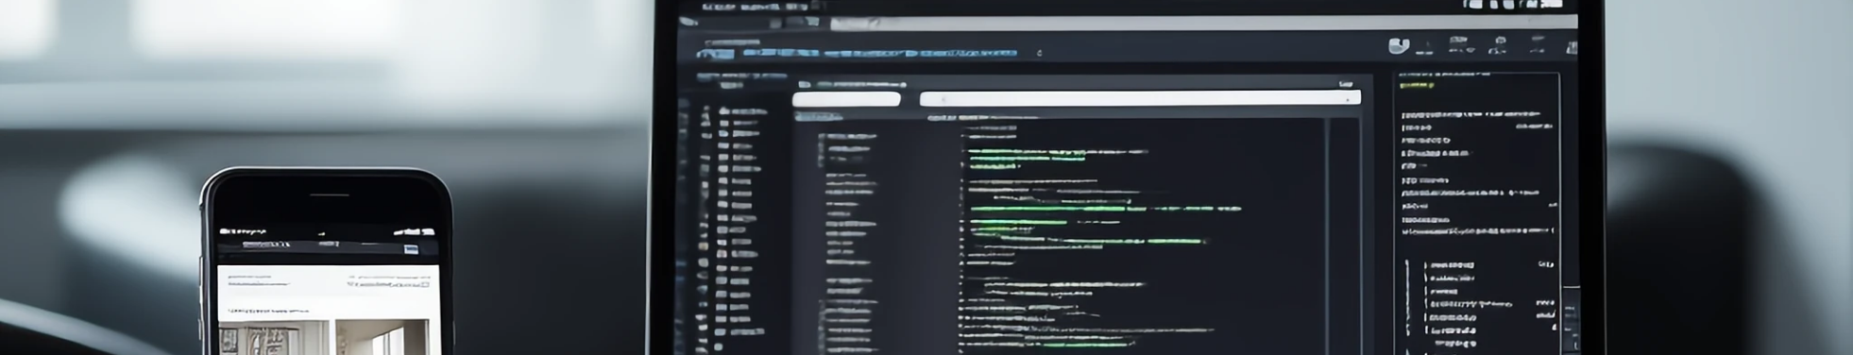
ARDENT COMPUTECH PVT. LTD.
Internship Course : Hybrid Mobile Application Development with React Native
Internship Duration: 4 WEEKS (09 July 2025 – 16 Aug 2025)
Name of the Supervisor : Mr. Subhojit Santra
PRESENTED BY : 1) BHAVYA PRASAD 2) OKAISH ALAM

Slide 2
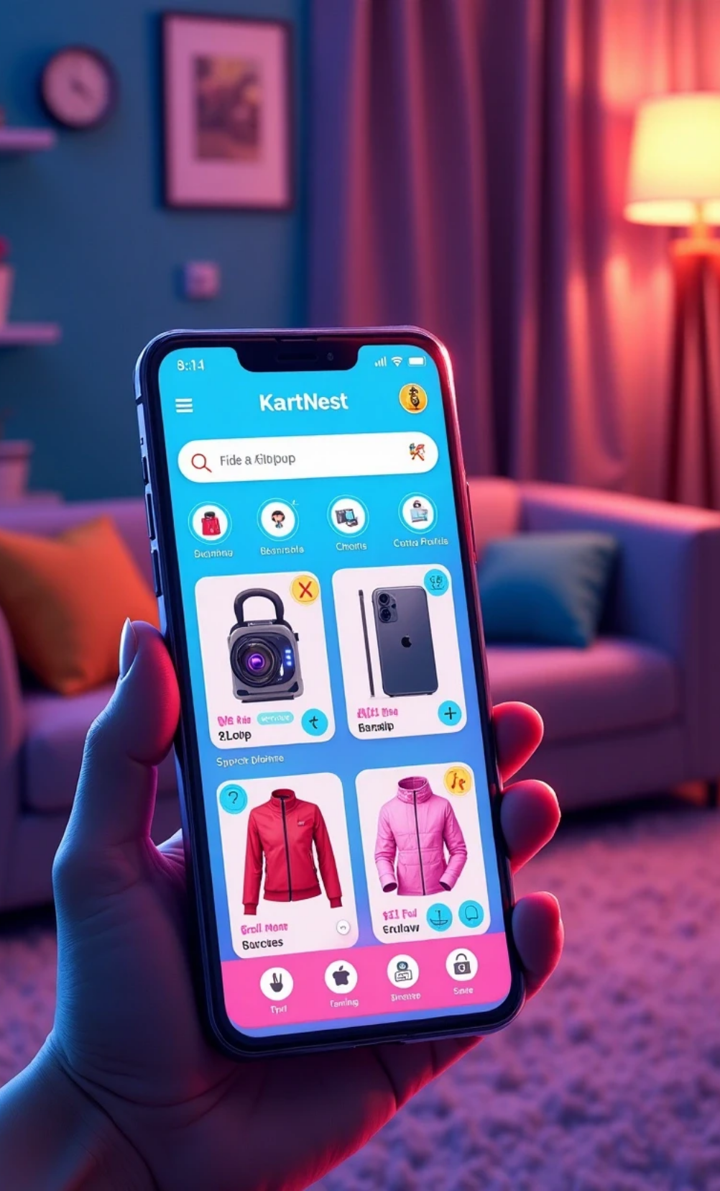
Project Title
KartNest – ONLINE BROWSING AND SHOPPING APP

Slide 3

CONTENTS
1. Acknowledgement
2. Introduction
3. Objectives
4. Scopes of the Project
5. Tools & Technologies Used
6. Company Profile
7. Objectives
8. Scopes of the Project
9. Tools & Technologies Used
10. System Design & Architecture
11. Challenges Faced
12. Contribution
13. Result
14. Conclusion
15. References

Slide 4
Acknowledgement
It is with great pleasure that we express our heartfelt gratitude to Mr. Subhojit Santra, our project guide, and Ardent Computech Pvt. Ltd. for providing us with the invaluable opportunity to work on the development of an e-commerce mobile application. Their constant guidance, encouragement, and insightful suggestions were instrumental in the successful completion of this project.
We are also thankful to our respective college, and the Training & Placement (TPO) Cell for facilitating this training program and creating an environment conducive to learning and skill development.
Finally, we would like to acknowledge the importance of teamwork in this journey. The collaborative spirit, shared problem-solving, and mutual support within our team played a key role in shaping this project into its present form.

Slide 5
Introduction
With the rapid growth of technology and the increasing demand for convenience, e-commerce has emerged as one of the most influential sectors in the global market. Mobile applications have further accelerated this trend by enabling users to shop anytime, anywhere.
In this context, our project, KartNest, was conceptualized and developed using React Native to provide a seamless and engaging online shopping experience. The application serves as a one-stop platform where users can browse products, explore detailed descriptions, and enjoy a modern, user-friendly interface.
The goal of KartNest is not just to display products but to enhance the overall shopping experience by combining aesthetic design with functional efficiency. This foundation also allows for future enhancements, such as integrating secure payment gateways, backend databases, and real-time order tracking, ensuring scalability and relevance in the evolving digital marketplace.

Slide 6





Objectives
The primary objectives of developing KartNest are:
To create a seamless and engaging online shopping experience by using React Native for a responsive and cross-platform application.
To design a user-friendly interface that enables customers to easily browse products, view detailed descriptions, and make informed purchasing decisions.
To establish a scalable architecture that supports future integration of backend functionalities such as secure payment gateways, product databases, and real-time order tracking.
To combine aesthetic design with functional efficiency to enhance user satisfaction and encourage repeat engagement.
To provide a one-stop shopping platform that meets the needs of diverse users while adapting to evolving trends in the digital marketplace.

Slide 7





Scopes of the Project
The scope of KartNest covers the design and development of a front-end mobile application for a general-purpose e-commerce platform using React Native. The current implementation focuses on:
Product Browsing: Enabling users to view a catalog of items with images, descriptions, and prices.
Responsive UI/UX: Delivering a visually appealing, user-friendly, and mobile-optimized interface.
Cross-Platform Support: Ensuring the application runs smoothly on both Android and iOS devices.
While the present version of KartNest is primarily focused on the front-end experience, the project is designed with scalability in mind. Future enhancements will include:
Integration of secure payment gateways.
Connection to backend databases for dynamic product management.
Real-time order tracking and inventory updates.
Personalized recommendations based on user preferences and purchase history.
The project scope is limited to the application’s user interface and core navigation flows for this phase, with backend functionalities to be implemented in subsequent stages.

Slide 8

09
Tools & Technologies Used

Slide 9





Development Tools
React Native CLI
JavaScript (ES6)
Node.js & npm
For building a cross-platform mobile application with native performance.
Core programming language for implementing application logic.
For managing dependencies and running React Native commands.
Android Studio
Visual Studio Code
For Android app development, testing, and emulation.
As the primary code editor with extensions for syntax highlighting, debugging, and version control.

Slide 10

10
System Design & Architecture

Slide 11

System Design & Architecture
The KartNest application is designed with a modular architecture to ensure scalability, maintainability, and a smooth user experience. The architecture separates concerns into distinct layers, allowing independent development and future upgrades without disrupting the entire system.

Slide 12

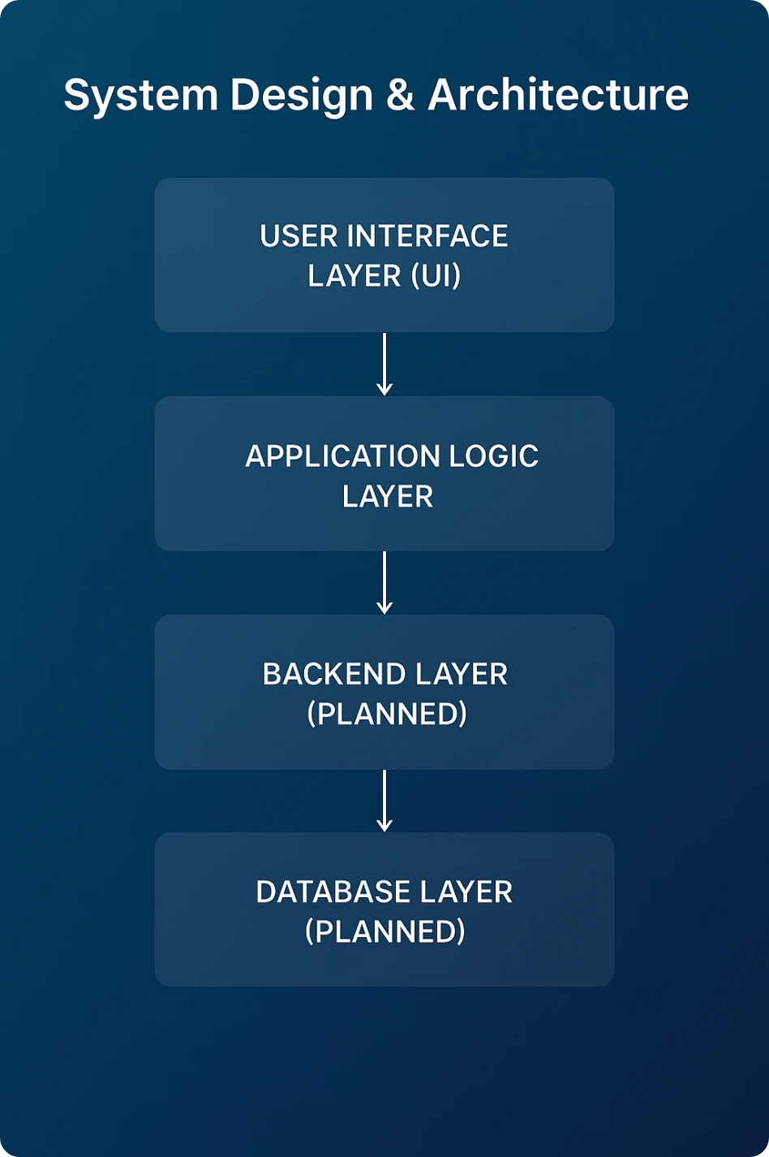
Architectural Layers
User Interface Layer (UI)
• Built using React Native components for a responsive and consistent look across Android and iOS.
• Handles visual presentation, product display, and user interaction.
Application Logic Layer
• Manages navigation using React Navigation.
• Controls state management, product filtering, and search functionalities.
Database Layer (Planned)
• Will handle user authentication, payment gateway integration, and order processing.
• Will use APIs to communicate with the mobile app for data transfer.
Backend Layer (Planned)
• Will handle user authentication, payment gateway integration, and order processing.

Slide 13




Challenges Faced
During the development of KartNest, the following challenges were encountered:
1
React Native Environment Setup
2
Cross-Platform UI Consistency
• Initially faced issues in configuring React Native CLI and setting up Android Studio due to dependency conflicts and emulator configuration errors.
• The app displayed slight layout differences between Android and iOS during testing, especially in padding, font rendering, and shadow effects.
• Solution: Followed official documentation and community forums to resolve environment path issues and updated dependencies to stable versions.
• Solution: Used platform-specific styling and React Native components that ensure consistent rendering on both platforms.
3
Navigation & State Management
4
Image Optimization
• Implementing smooth navigation between screens while maintaining state across components was challenging.
• High-resolution product images affected load times and overall performance.
• Solution: Integrated React Navigation and used React Hooks for efficient state handling.
• Solution: Optimized images by reducing file sizes and using appropriate resolution for mobile devices.

Slide 14

12
Contribution

Slide 15



Team Member 1: Bhavya Prasad
Built reusable components for product cards, buttons, and bottom navigation bars.
Designed and implemented Login and Signup screens with user authentication functionality.
Created the Category-wise Listing screen, displaying two product cards per row for better visual organization.
Implemented Add to Cart functionality using useState to dynamically increase or decrease product quantities.
Team Member 2 : Okaish Alam
Developed the Cart Screen UI with product summary and checkout option.
Worked on designing the Home Screen layout including banners, search bar, and category navigation.
Assisted in resolving cross-platform UI issues between Android and iOS .
Contributed to testing, debugging, and optimizing image rendering for better performance.

Slide 16
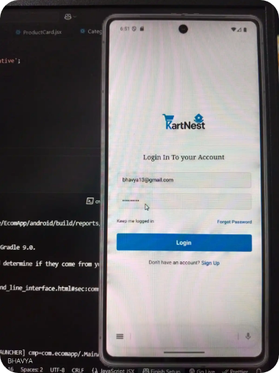
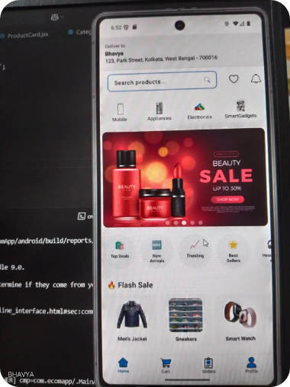
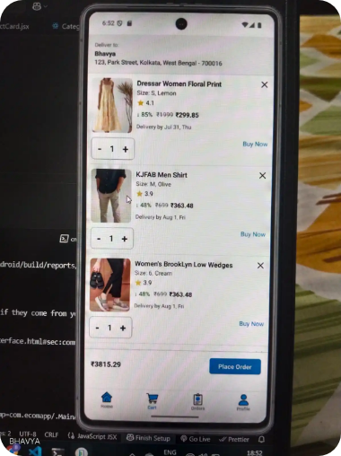
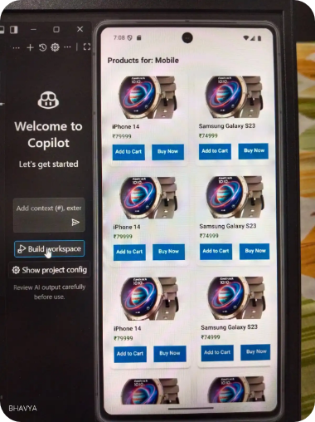
Result
1 ) Login Screen - The Login Screen of KartNest is designed using React Native. At this stage, the authentication process is implemented on the frontend only, allowing users to input credentials and navigate within the app. Backend services for actual user authentication and secure data handling are planned for future integration.
2) HomeScreen - Key features include personalized delivery address display, category-based product navigation, search functionality, promotional banners, curated product sections (Top Deals, New Arrivals, Trending, Best Sellers), flash sale highlights, and a bottom navigation bar for easy access to main screens. The app ensures smooth navigation, quick product discovery, and an engaging shopping experience.
3 ) CartScreen – Used useState management to add the functionality of adding/subtracting the quantities from the cart.
4) Category-wise Listing Screen - The app successfully displays products filtered by the selected category. Each product card includes an image, name, price, and action buttons (“Add to Cart” and “Buy Now”), ensuring a clear and user-friendly browsing experience.

Slide 17
Conclusion
The development of the e-commerce mobile application successfully achieved its primary objectives of providing a seamless shopping experience through a clean interface, efficient navigation, and essential features such as user authentication, category-based product listings, and cart management with quantity control.
Throughout the project, we strengthened our technical skills in React Native, component reusability, state management, and responsive UI design. The implementation of reusable components and logical navigation flow ensured scalability and maintainability for future enhancements.
This project not only improved our problem-solving and teamwork abilities but also demonstrated our capacity to design and develop a mobile application that can be extended to include advanced features such as real-time backend integration with MongoDB, secure payment gateways, and order tracking systems.
In conclusion, the application serves as a functional prototype of a scalable e-commerce platform, reflecting both our technical growth and readiness for more complex development challenges.

Slide 18

References
https://reactnative.dev/docs/environment-setup
https://reactnavigation.org/docs/getting-started/
https://nodejs.org/docs/latest/api/
https://developer.android.com/studio
https://docs.github.com/en

Slide 19

Thank You

